Slide 1
Automation
Python for

Slide 2
Rob Carrington
4 years as a Python developer
Worked in FinTech (@Q2eBanking)

Slide 3



Q2

Slide 4
What is Automation good for?

Slide 5

Text

Slide 6


Slide 7
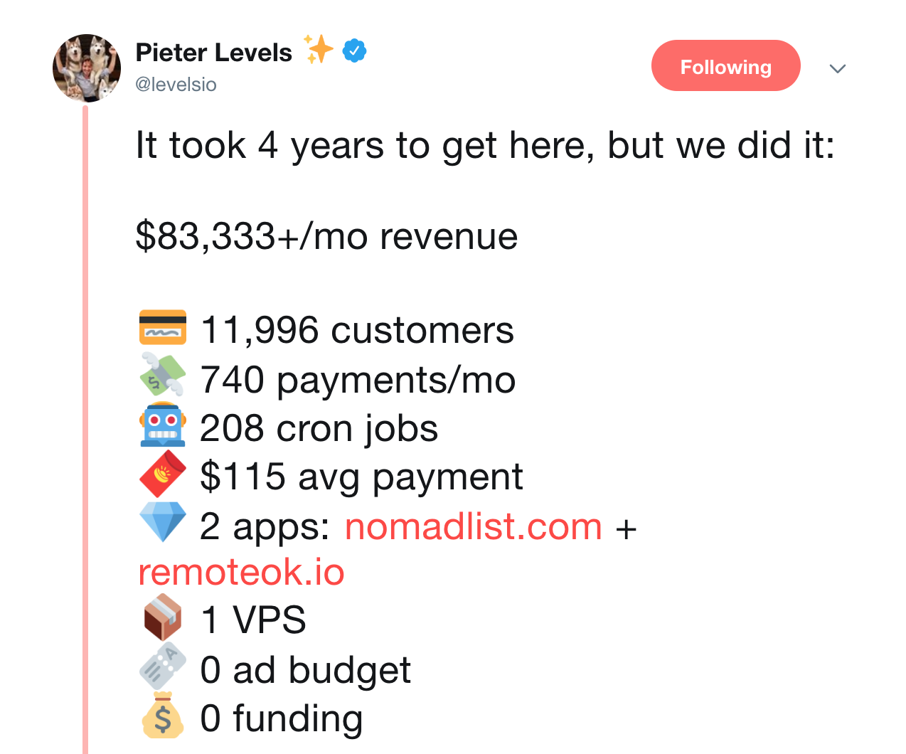
Text

Slide 8
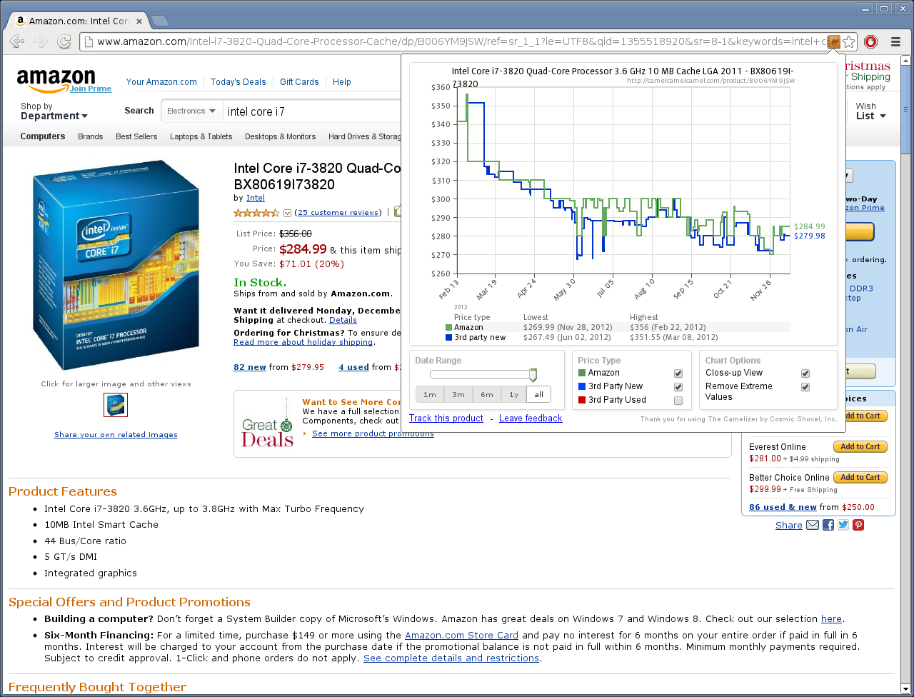
Text

Slide 9
Class format

Slide 10
Class format

Slide 11

Class format
10 minutes for lesson & demo
15 minutes for exercise
Pause to review & ask questions
Rinse and repeat

Slide 12
Demo

Slide 13
HTML & CSS Selectors

Slide 14

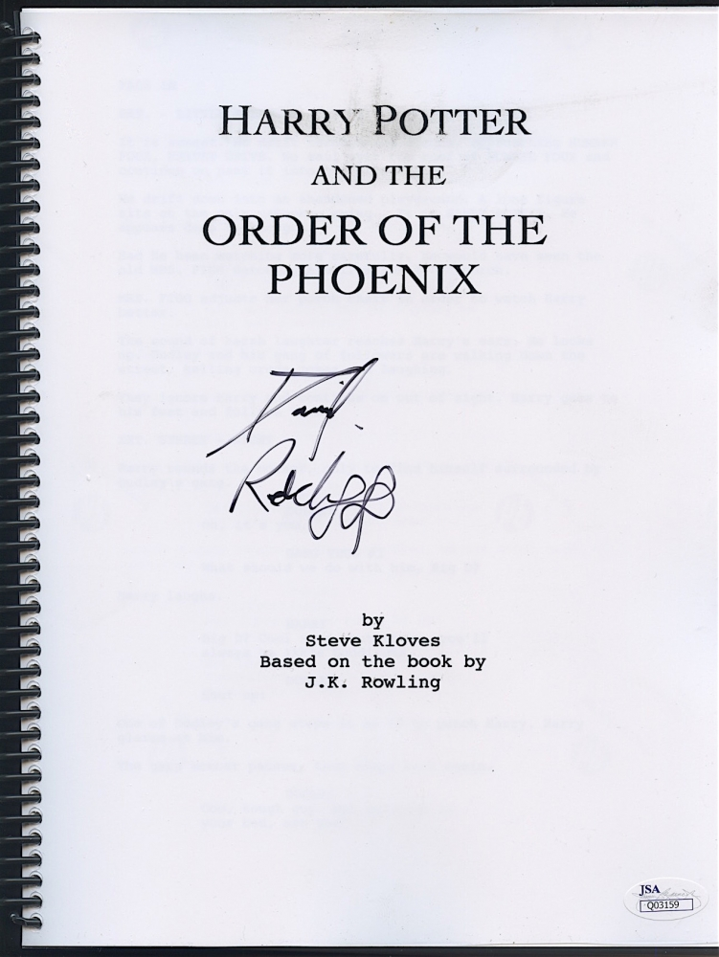
HTML

Slide 15
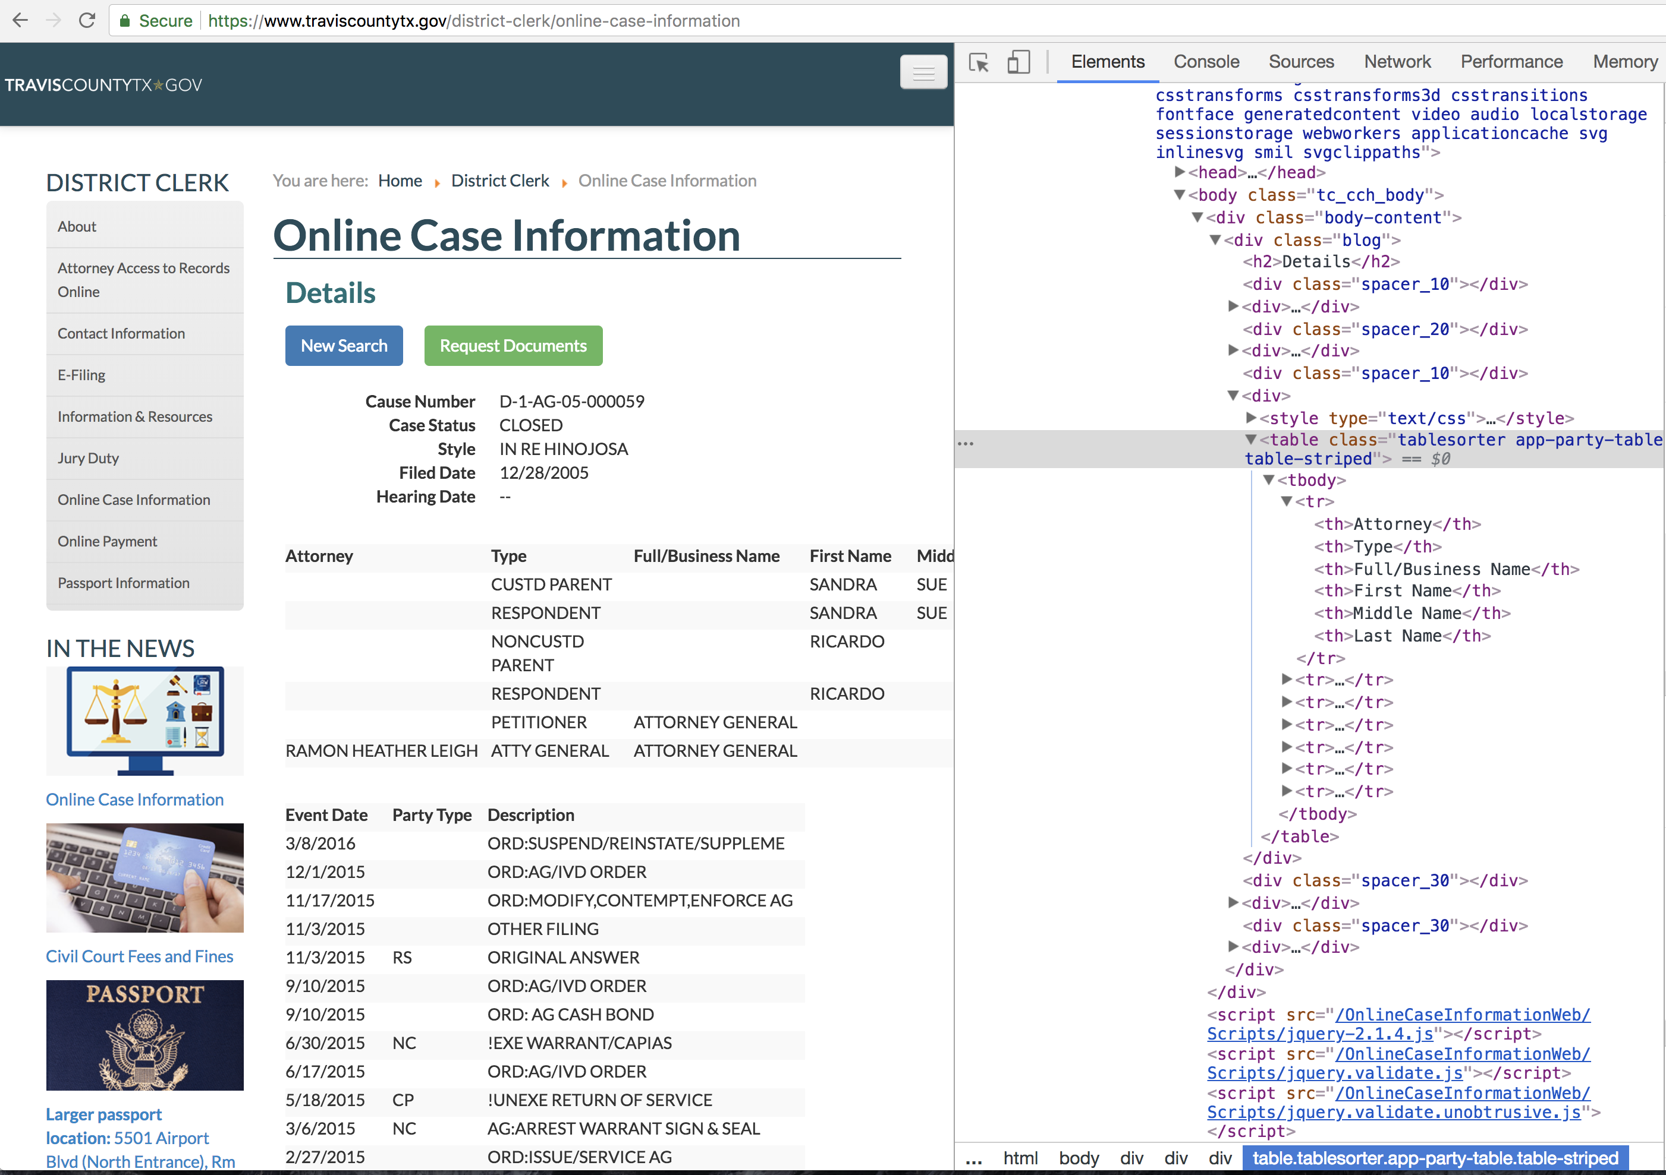

Slide 16
Anatomy of an HTML ELEMENT
<body>text goes in here</body>

Slide 17
Anatomy of an HTML ELEMENT
<body>text goes in here</body>
Tag indicates part of the webpage

Slide 18
Anatomy of an HTML ELEMENT
<body>
<h2 id=“title”>a header</h2>
</body>

Slide 19
Anatomy of an HTML ELEMENT
<body>
<h2 id=“title”>a header</h2>
</body>
Element has attributes like id, class, etc

Slide 20
Anatomy of an HTML ELEMENT
<body>
<h2 id=“title”>a header</h2>
</body>
Elements get nested together

Slide 21
Css Selectors
Tag —> h2

Slide 22
Css Selectors
Tag —> h2
Id —> #title

Slide 23
Css Selectors
Tag —> h2
Id —> #title
Class —> .header

Slide 24
Css Selectors
Tag —> h2
Id —> #title
Class —> .header
Attribute —> [name=“ssn”]

Slide 25
Combining selectors
.main#feature

Slide 26
selecting Child Elements
#hello > a

Slide 27
Exercises

Slide 28
On a Craigslist Post
Pick out only the title text
Grab the price
Pick out the <time> tag
Grab all the images under the div with class of “swipe-wrap”

Slide 29
On a Craigslist Post
Extra Credit: get the post-id from the bottom of the page
Hint: If you are using the > symbol to select all children, you can add :nth-child(1) to grab just the first child.

Slide 30

Selenium
Automating chrome with

Slide 31

Text

Slide 32
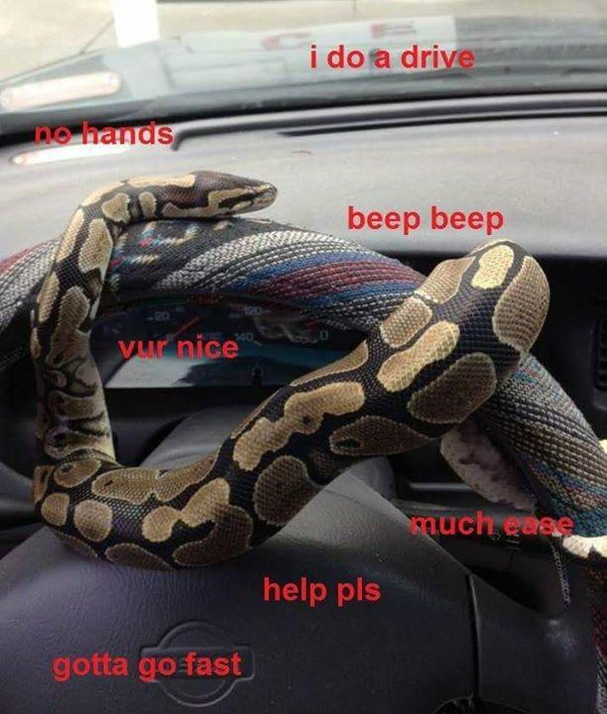

Slide 33



Chrome Driver

Slide 34
importing selenium
from selenium import webdriver

Slide 35
chrome web driver
webdriver.Chrome(“./chromedriver")

Slide 36
Navigating to URL
driver.get(“www.craigslist.com”)

Slide 37
Selecting links
.find_element_by_link_text(“next”)

Slide 38
Selecting anything
.find_element_by_css_selector(“p”)

Slide 39
Exercises

Slide 40
Extract text
element.text

Slide 41
extract attribute
element.get_attribute(“href”)

Slide 42
Input text into fields
element.send_keys(“how to surf”)

Slide 43
Take a screenshot
driver.save_screenshot(“me.jpg”)

Slide 44
Python review

Slide 45
Values: What kinds ARE THERE?
Int
Float
String

Slide 46
Mixing data types
1 + 7.0 = 8.0

Slide 47
Mixing data types
1 + 7.0 = 8.2
1 + “7.0” = error

Slide 48
Mixing data types
1 + 7.0 = 8
1 + int(“7.0”) = 8.0

Slide 49
For-Loops
Repeats a chunk of code
Hands in different item each time

Slide 50
For-loops
pets = [“dog”, “cat”, “fish”]
for pet in pets:
print(pet)

Slide 51
For-loops
pets = [“dog”, “cat”, “fish”]
for pet in pets:
print(pet)

Slide 52
For-loops
pets = [“dog”, “cat”, “fish”]
for pet in pets:
print(“dog”)

Slide 53
For-loops
pets = [“dog”, “cat”, “fish”]
for pet in pets:
print(“cat”)

Slide 54
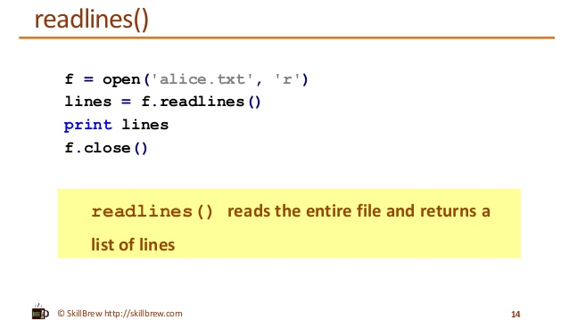

Slide 55

Gmail
automating

Slide 56
Exercises

Slide 57
Projects

Slide 58

Response
Automated email

Slide 59

Research
Automated

Slide 60
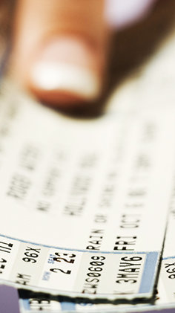
Alert
Automated ticket

Slide 61
Advanced Topics

Slide 62
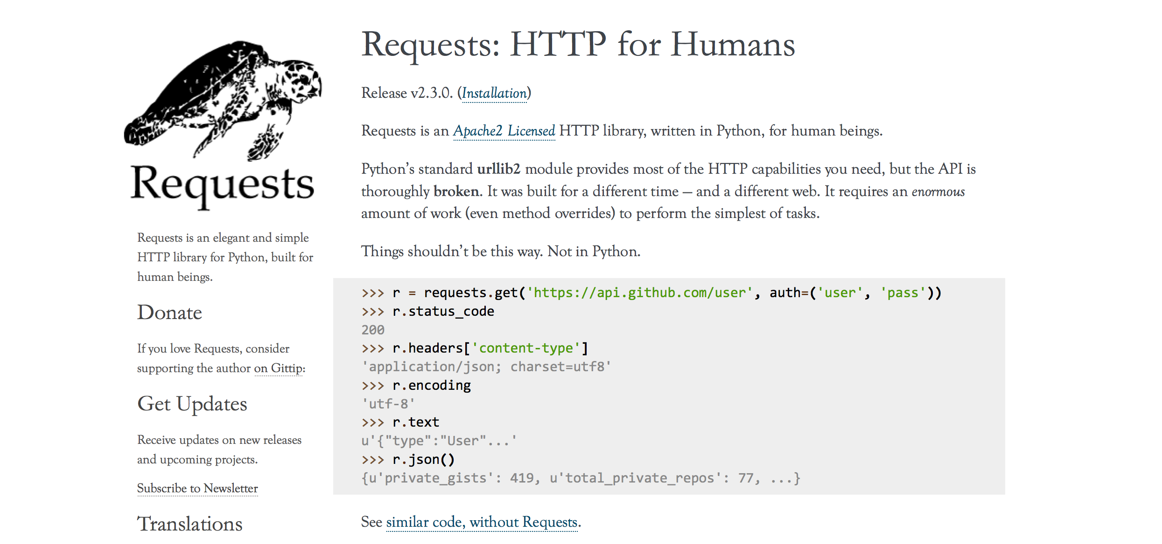
Text

Slide 63
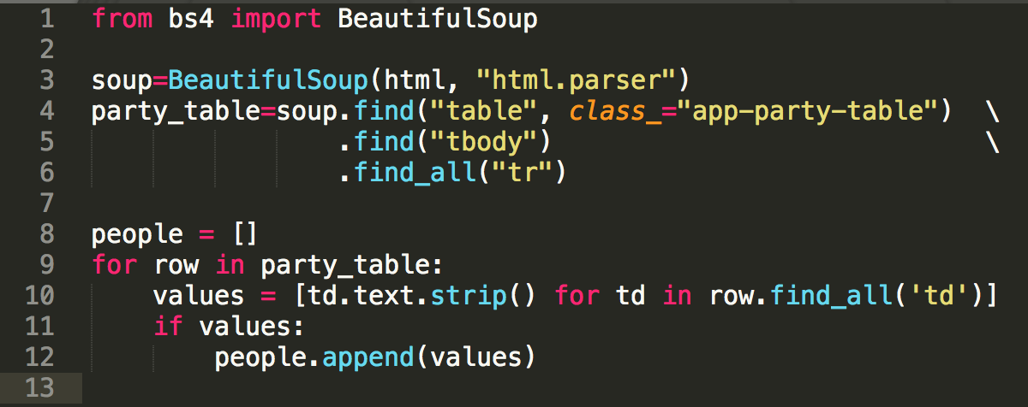
Beautiful Soup
Helps Python extract data from HTML

Slide 64
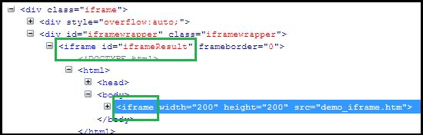
iframes

Slide 65

APIs
Made for robots, not human eyeballs
Like a website without the visuals

Slide 66
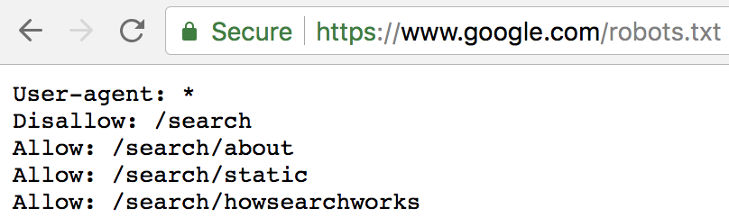
robots.txt
Tells webscraping programs where they should/shouldn’t go

